Slide 1
IMAGE SEGMENTATION USING NORMALIZED CUT
MOHAMED SAHIM J
205229121

Slide 2
IMAGE SEGMENTATION
In digital image processing and computer vision, image segmentation is the process of partitioning a digital image into multiple segments.
It helps in reducing the complexity of the image to make further processing or analysis of the image simpler.
Image segmentation is a grouping technique used for image. It is a way of dividing an image into different regions that possess similar properties such as intensity, texture, color etc.

Slide 3
NORMALIZE CUT
We treat image segmentation as a graph partitioning problem and propose a novel global criterion, the normalized cut, for segmenting the graph.
The normalized cut criterion measures both the total dissimilarity between the different groups as well as the total similarity within the groups

Slide 4
NORMALIZED GRAPH CUT
A graph-cut is a grouping technique in which the degree of dissimilarity between these twogroups is computed as the total weight of edges removed between these 2 pieces

Slide 5
DRAWBACK OF GRAPHCUT
The minimum cut criteria occasionally supports cutting isolated nodes in the graph due to the small values achieved by partitioning such nodes.

Slide 6
REQUIREMENTS
OPEN CV
NUMPY
MATPLOTLIB
SK IMAGE

Slide 7
IMPLEMENTATION

Slide 8
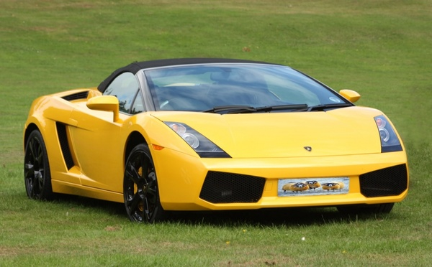
INPUT IMAGE

Slide 9
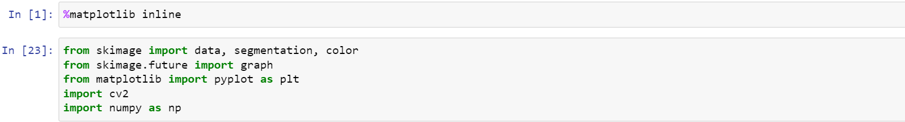
CODE

Slide 10
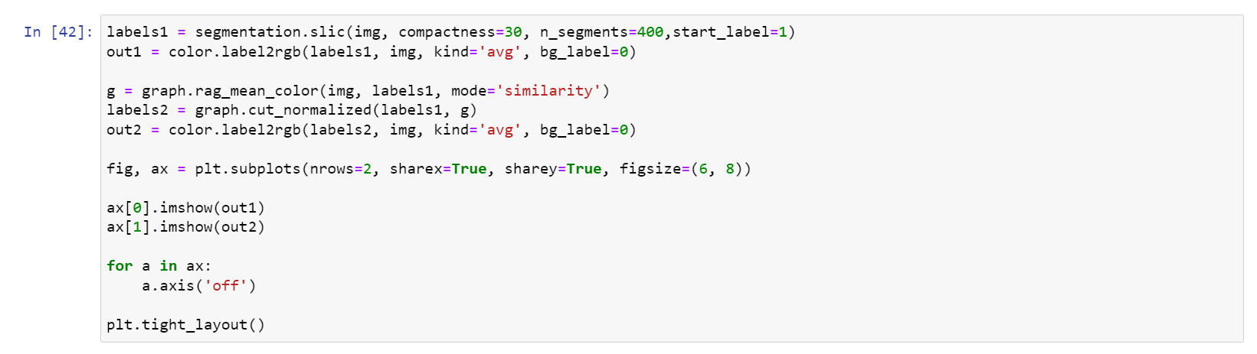
NORMALIZE CUT

Slide 11
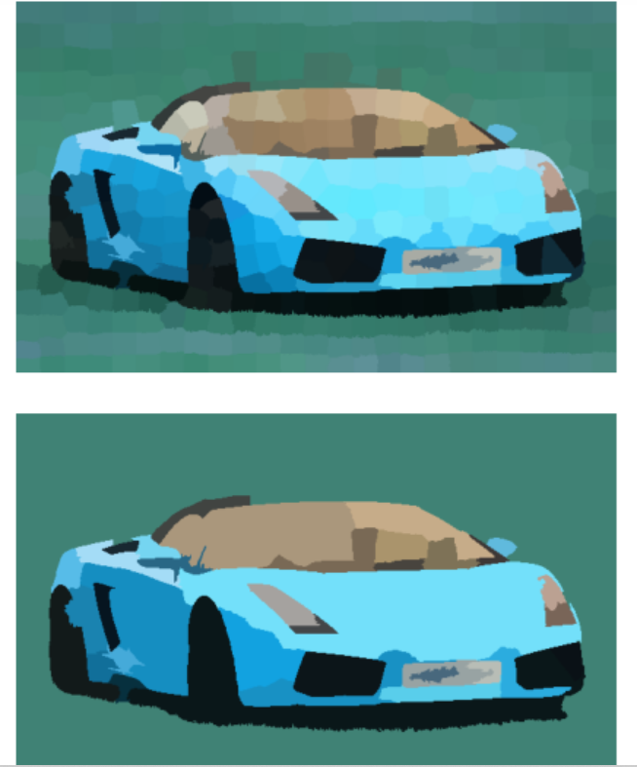
OUTPUT IMAGE

Slide 12
REFERENCE
YOUTUBE
GIT HUB
https://scikit-image.org/docs/dev/auto_examples/segmentation/plot_ncut.html

Slide 13
THANK YOU

